Slide 1


Deep Learning Theory and Applications Kernel Methods and Neural Tangent Kernels
CPSC/AMTH 663

Slide 2
Outline
Kernel Methods and Neural Networks
Linearization of gradient
Lazy Regime
Gradient Flow
Kernel Methods and Generalization

Slide 3
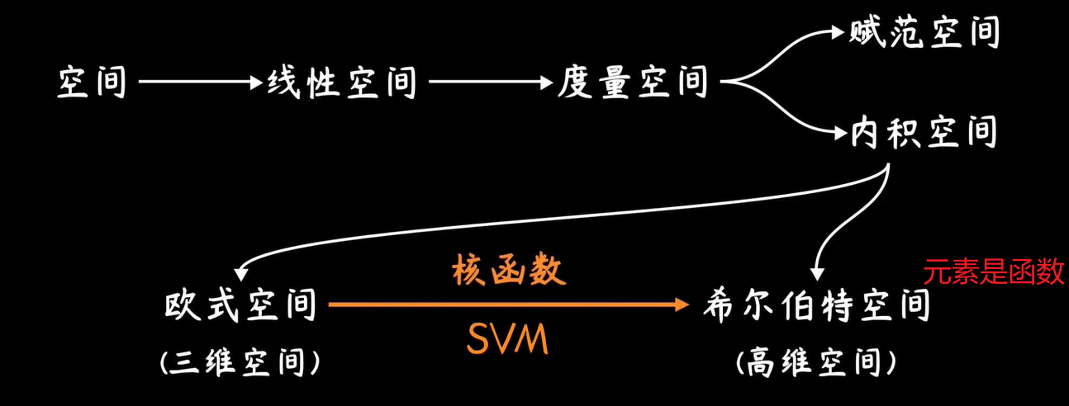

Slide 4
NTK and Generalization
In the infinite width or large scale scenario neural networks become equivalent to a kernel method
This creates a very interesting connection between neural networks and kernel methods
This kernel method uses a specific kernel called the Neural Tangent Kernel
Neural networks become equivalent to kernel ridge regression
Such a method is a linear method on top of a non-linear feature map
Using SGD to solve this starting from low norm-initialization leads to a low functional norm, stable, generalizable solution

Slide 5
NTK and Gradient Descent
In the infinite width or large scale scenarios the weights of a neural network don’t move very much during training
The derivative of weights WRT Loss function L is very close to linear
In this regime SGD can be written as a kernel gradient with the neural tangent kernel
Using this kernel one can study gradient descent more mathematically
Interesting result: One can prove that gradient descent converges to the global minima here

Slide 6
What is a kernel Method?
Intuitively, A kernel method is a method that uses similarities between points rather than reasoning about features to perform a task (clustering, classifying etc)
A kernel function is a similarity function between datapoints on the basis of the feature vector
Ex: Gaussian kernel
Similarity functions are symmetric and non-negative

Slide 7
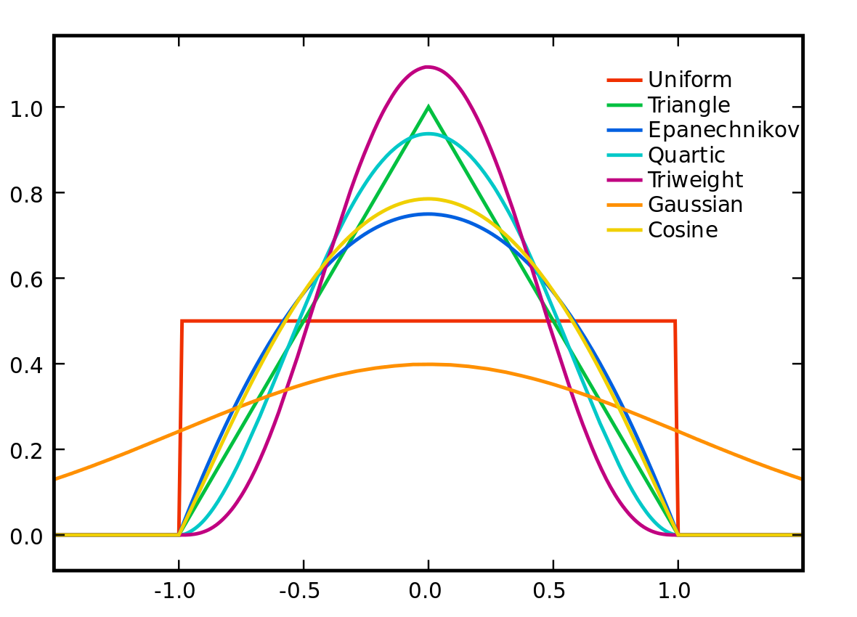
Distance to Affinity via Kernels
Real-valued
Non-negative
Symmetric
Affinities correlations in this hidden hypothetical space

Slide 8
Kernel Methods
Mathematical definition: K is a kernel function if it can be written as the inner product of two feature maps in an m dimensional space
K(x, y) = <f(x), f(y)>
Here K is the kernel function, x, y are n dimensional inputs.
f is a feature-map from n-dimension to m-dimension space
< x,y> denotes the dot product
Usually m is much larger than n

Slide 9
Kernel Matrix
Kernel Methods often use a matrix of pairwise similarities
This matrix is often called a kernel matrix M(i,j) = K(x_{i}, x_{j})
Each row of a kernel matrix gives the similarity of a datapoint x_{i} with all other datapoints x₁,x₂, … x_{n}
Kernel matrices have nice properties if you use a proper similarity function
Kernel matrices are positive-semidefinite matrice
PSD matrices z^{T}Mz is always positive for any non-zero vector z
They are symmetric matrices
Eigenvalues are all greater than or equal to 0

Slide 10
Kernel Trick
Mercer’s Theorem Result: If M is a non-negative positive semi-definite matrix of dimension n x n, then it is the Gram matrix (matrix of inner products) of the data vectors in another space V
This space is usually higher dimensional and involves “lifting” of vectors via a feature map, x_{i}-> ⏀(x)
This space V could be infinite dimensional and does not have to be found!
(But we do find them in NTK)

Slide 11
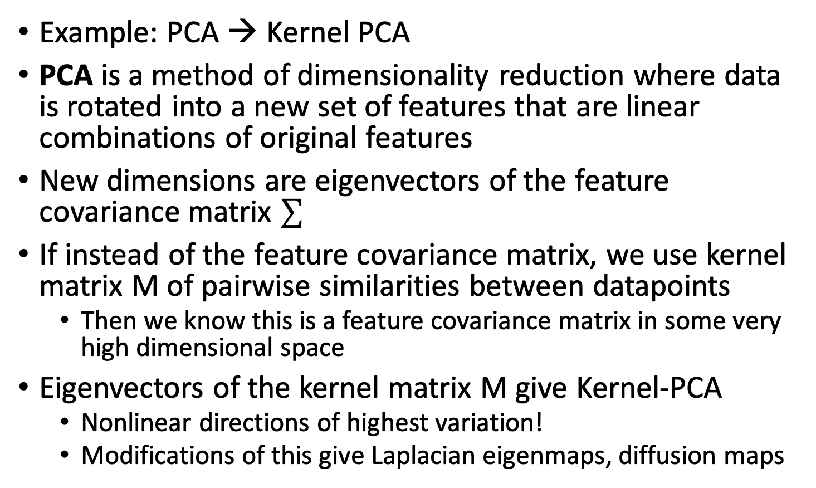
Linear methods to find non-linear functions
Example: PCA → Kernel PCA
PCA is a method of dimensionality reduction where data is rotated into a new set of features that are linear combinations of original features
New dimensions are eigenvectors of the feature covariance matrix $∑$
If instead of the feature covariance matrix, we use kernel matrix M of pairwise similarities between datapoints
Then we know this is a feature covariance matrix in some very high dimensional space
Eigenvectors of the kernel matrix M give Kernel-PCA
Nonlinear directions of highest variation!
Modifications of this give Laplacian eigenmaps, diffusion maps

Slide 12
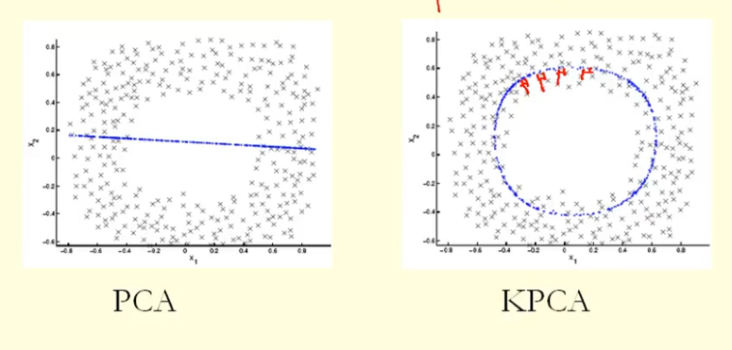
PCA vs Kernel PCA
Linear algorithm applied to find non-linear dimensions using kernel trick!

Slide 13
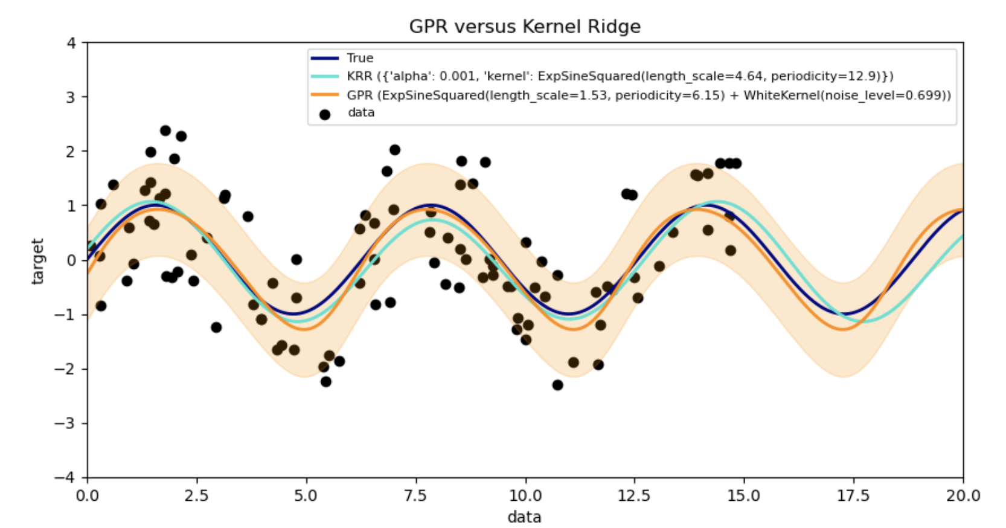
Kernel Ridge Regression
Kernel ridge regression (KRR) combines ridge regression (linear least squares with l2-norm regularization) with the kernel trick
Learns a linear function in the space induced by the respective kernel and the data
For non-linear kernels, this corresponds to a non-linear function in the original space

Slide 14
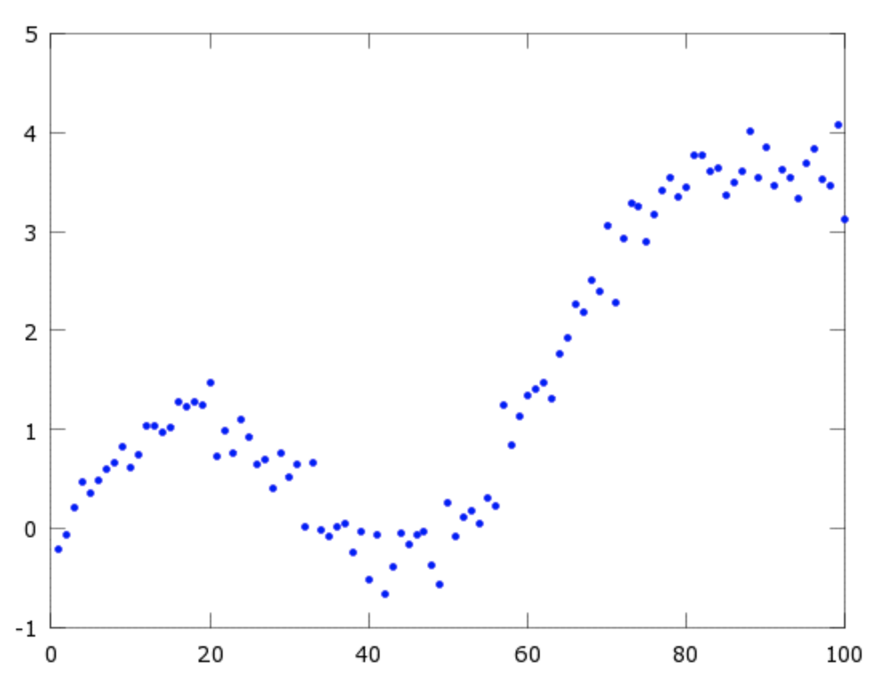
Kernel Regression
Suppose we want to know the value of y for a point x=60 for some non-linear function
We are given the value of the function at several points x₀ x₁ x₂ … x_{n}
Idea: We should look at nearby x values in the training data, the closer the training datapoint is to x=60 the more relevant its y value for our estimation

Slide 15
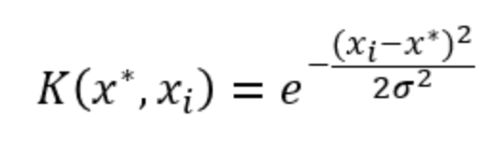
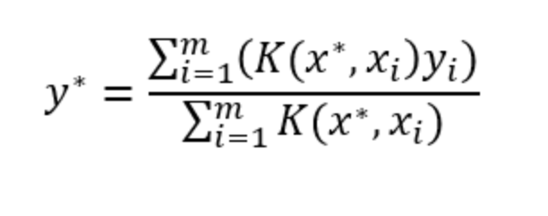
Gaussian Kernel
We can formalize this notion using a Gaussian Kernel
Then to estimate a y, we just need a weighting function
Our kernel has one parameter, sigma or the bandwidth, the NTK kernel has many, and the neural network tunes them during training in a certain regime

Slide 16
Ridge regression
They perform ridge regression or minimize L2 loss because of the Neyshambur theory
SGD prefers low norm solutions when initialized to low norm initializations

Slide 17
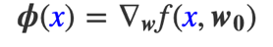
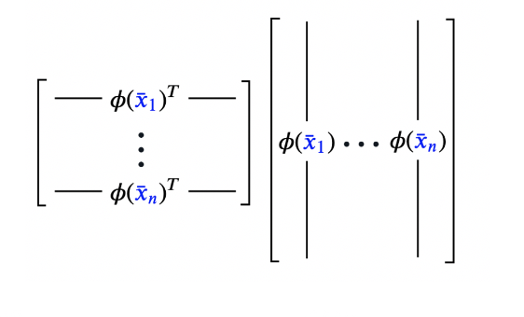
NTK as an explicit mapping
NTK maps datapoints to a new feature space based on their derivative around the initialization of the neural network, i.e. how sensitive the output at that x is to changes in the parameters
This is the new explicit feature map
Inner products in this feature map give you a notion of similarity and can be used to create a kernel matrix

Slide 18
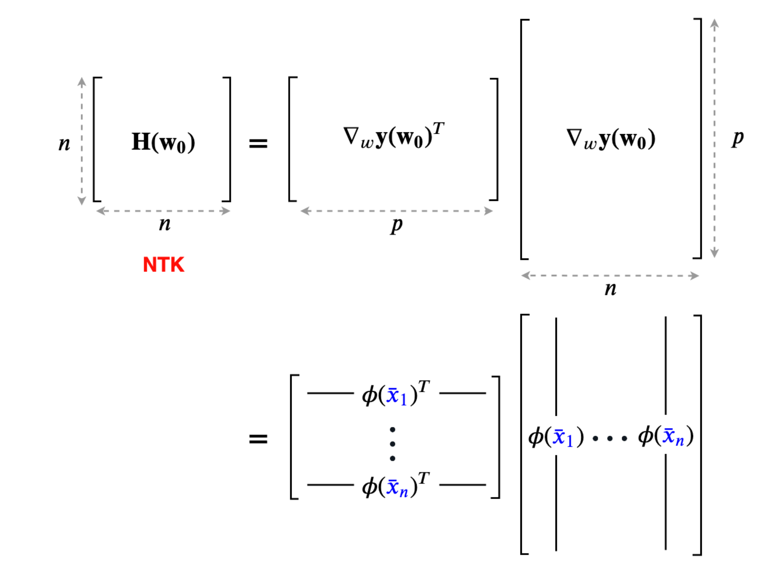
Neural Tangent Kernel Matrix

Slide 19
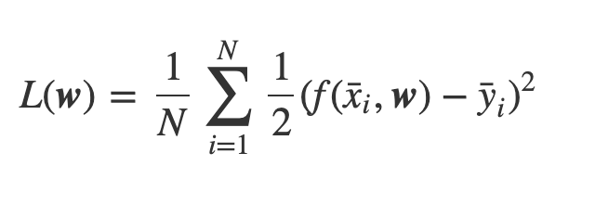
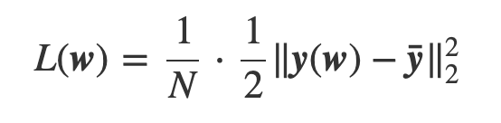
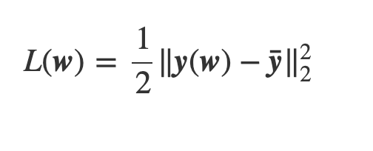
Full Batch Gradient Descent
In this regime we will be studying full batch gradient descent, i.e., gradient descent on the whole dataset
The expression for this can be simplified

Slide 20
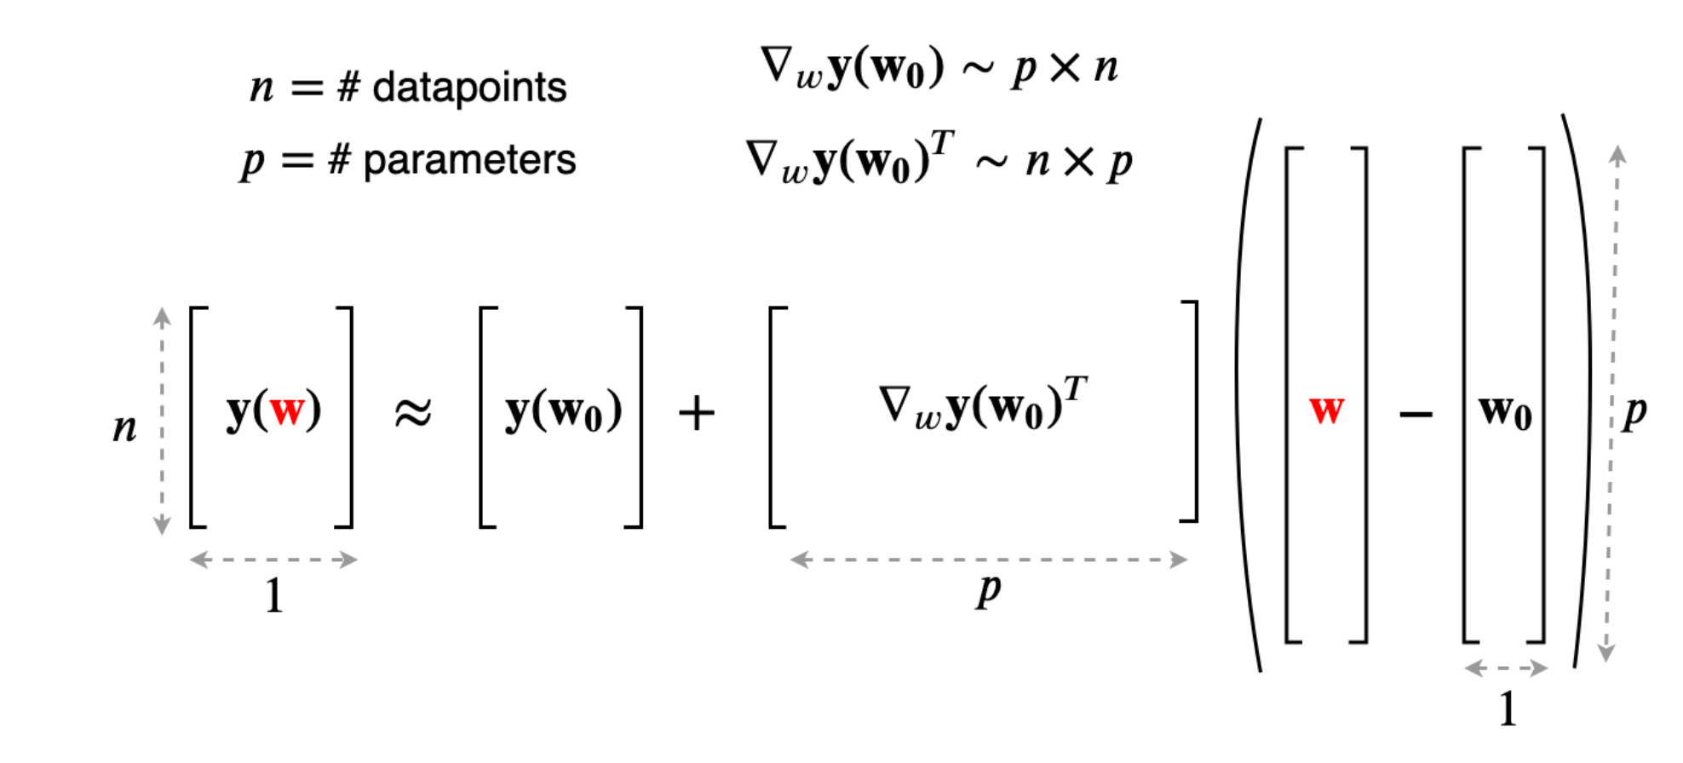
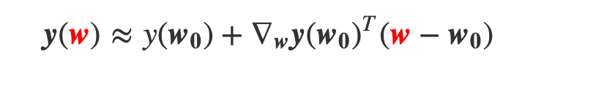
Taylor Expansion of weights around initialization

Slide 21
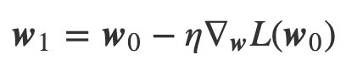
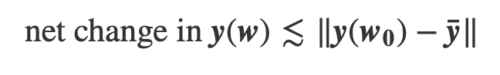
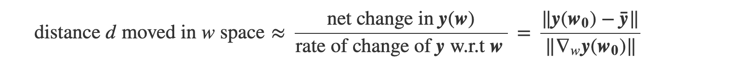
The lazy regime
This model is only a good approximation in the lazy regime where the Jacobian does not change much during training

Slide 22
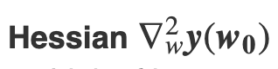
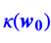
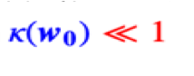
Negligible Change in Jacobian
referred to as
Means that the change in w required to produce a change in the function causes a
Negligible change in the Jacobian
Thus the model is very close to its linear approximation

Slide 23
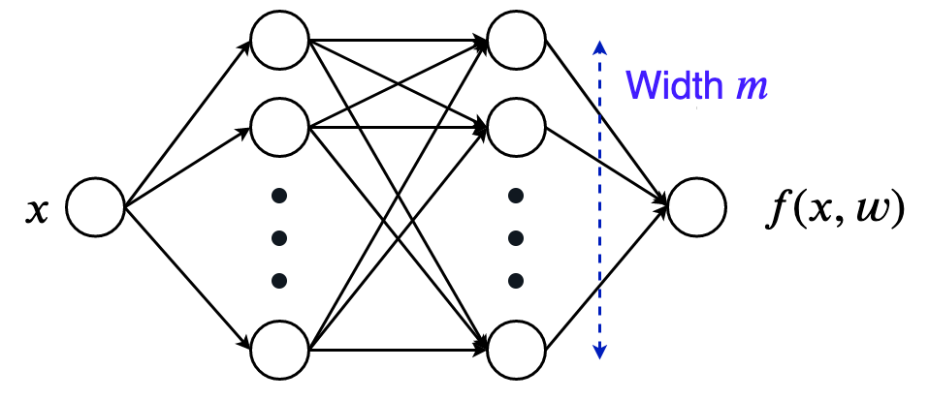
Width of Network

Slide 24
Infinite width limit
The initial NTK of the network is a deterministic kernel as the width increases
In the infinite limit the kernel stays constant as we optimize the weights
Thus, the network is computing a kernel ridge regression
SGD is actually doing kernel gradient descent which can be proven to have an optimal minima

Slide 25
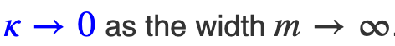
Relationship to network width
A large width for a neural network means that there are a lot of neurons affecting the output
Why does this mean that the change in the Jacobian is small??
A small change in all of these neuron weights can result in a very large change in he output, so the neurons need to move very little to fit the data.
If the weights move less, the linear approximation is more accurate.

Slide 26
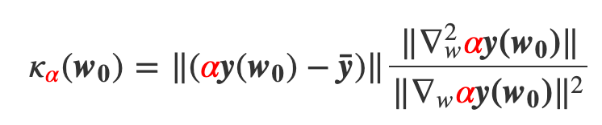
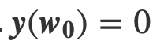
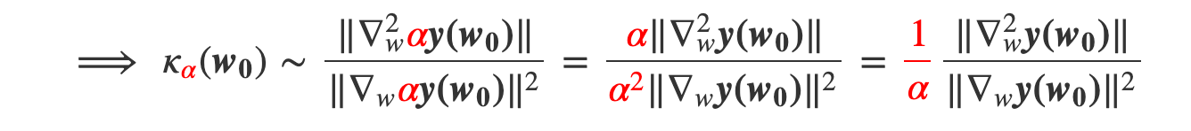
Relationship to scale
Lets try rescaling the output y by a factor a
Assume

Slide 27

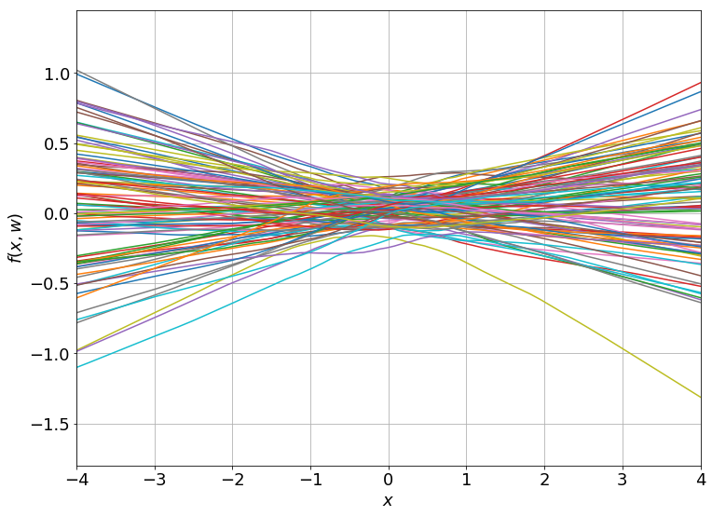
Random Initializations
Equivalent to random functions drawn from a Gaussian Process

Slide 28
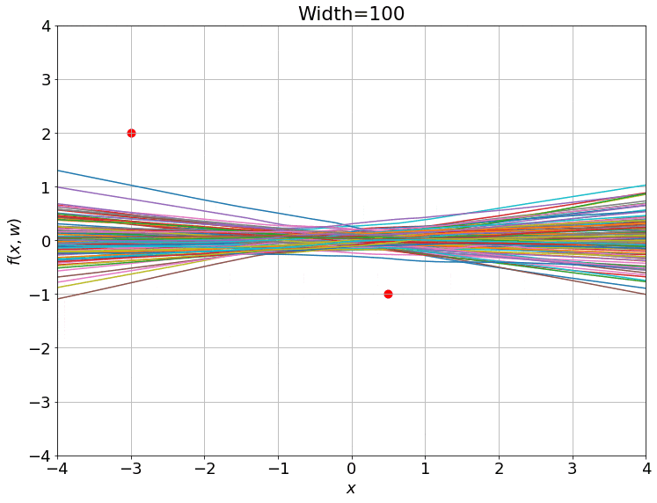
After training with GD

Slide 29
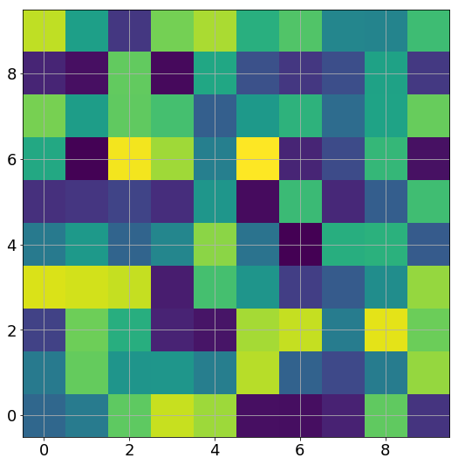
Training of the weights

Slide 30
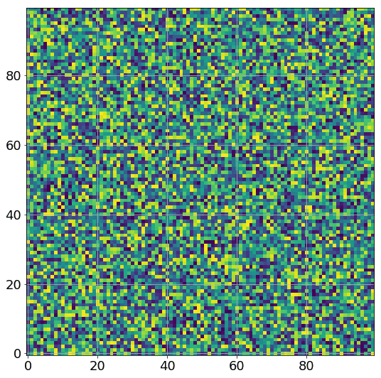
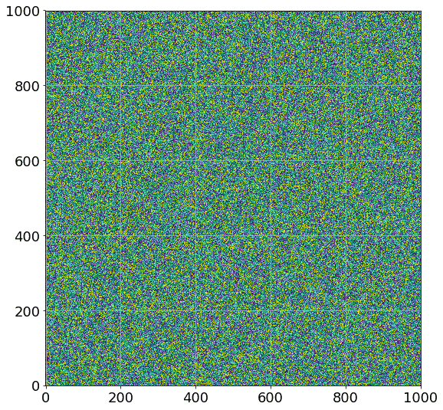
Increasing width, Weights don’t Budge!

Slide 31
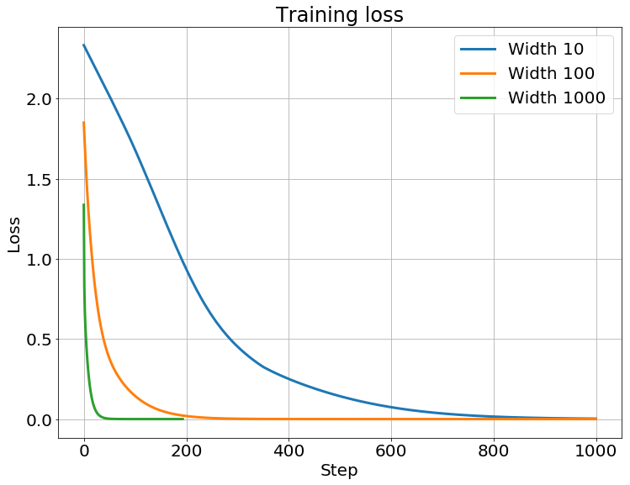
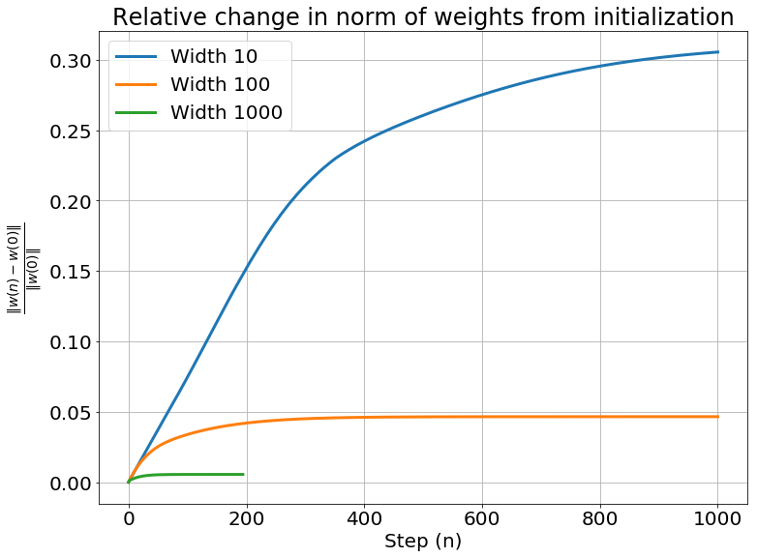
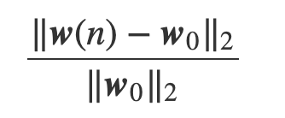
Relative Change in weights w/training

Slide 32
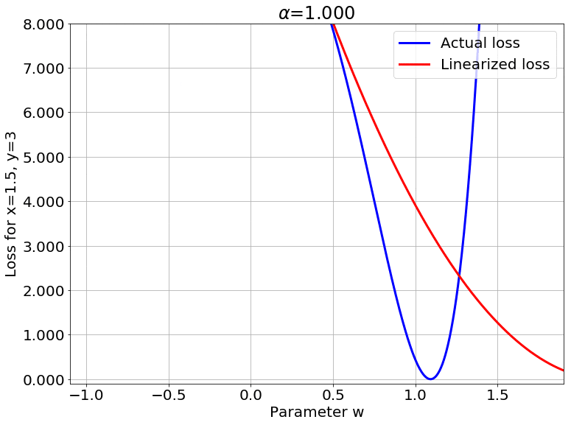
Actual vs Linearized Loss

Slide 33
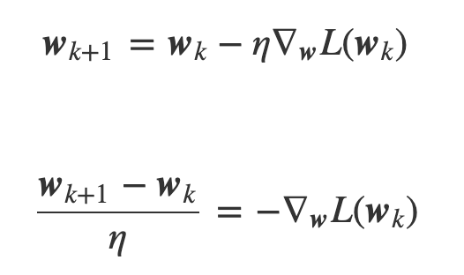
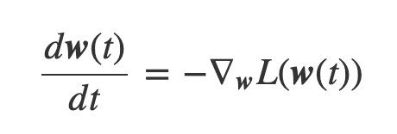
Continuous evolution of weights
We can the evolution of weights as a differential equation and study it continuously in time
This is a finite difference equation but lets take learning rate to be very small to turn into a diff eq

Slide 34
Gradient flow
This continuous version of the weight derivative is called Gradient flow
Think of a continuous version of stochastic gradient descent
Trajectory of this gradient over time closely follows GD in the lazy regime

Slide 35
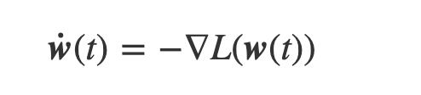
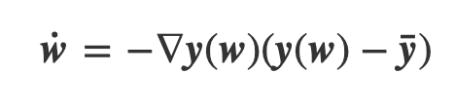
Simplified Gradient Flow
Dot notation for derivatives gives
Dropping time variable from equation, and writing out the loss function gives

Slide 36
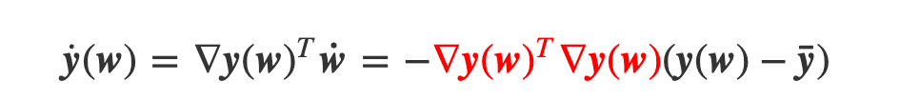
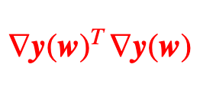
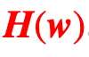
Output Dynamics
To get model output dynamics apply chain rule on
Recall the Neural Tangent Kernel, this is the associated matrix (matrix of inner products)
Give it a new symbol
Recall this is the matrix induced by the kernel feature map

Slide 37
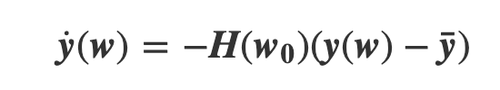
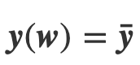
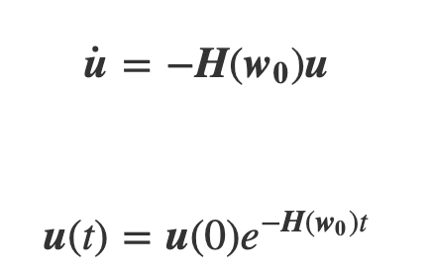
Training in the Kernel Regime
Training changes to simple ODE solving
Set
This is the solution or equilibrium of the ODE
If the matrix can be diagonalized then exponent of matrix is just the exponent applied to the eigenvalues

Slide 38
Descent along Eigenvectors of NTK
H(w₀) positive semi-definite
Lets assume we have no 0 eigenvalues, then it is positive definite
This means that we can eigendecompose H(w₀)
Eigendecomposition decomposes the gradient into n independent directions we have to go
Steps in these directions causes those eigenvalues to decay
Eventually gradient will be 0
This is also our global minimum solution where y(w)-y!

Slide 39
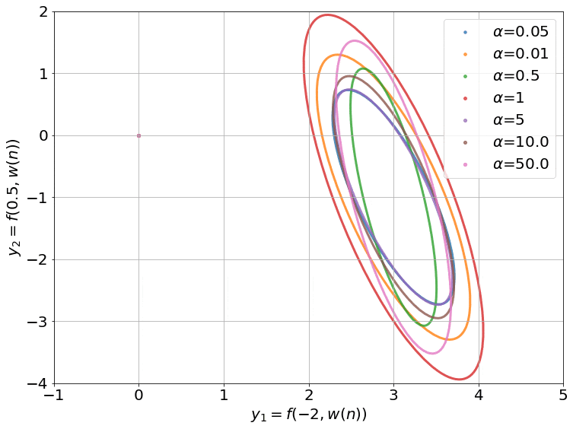
Eigenvector Decay Visualized
This is the case of a 2-point dataset
Notice this is also happening with small alpha! Why?

Slide 40
Generalization
Training the model in the kernel regime is equivalent to solving a linear system.
Happy that gradient descent does something reasonable in this domain!
What does this mean for generalization?
This system of equations is under-determined as you increase width to infinity
However it can be shown that in the infinite width limit this converges to the minimium norm solution
Gradient descent chooses that solution which has minimum ‖w‖2 as long as you start with a low norm initialization
Thus this has small complexity in terms of Neyshambur et al.

Slide 41
Are NTKs equivalent to NNs?
Turns out they are not equivalent
Neural networks generally perform better than NTKs even at “infinite width limit”
This means that NTKs are actually missing something
Recently proposed: enhanced NTKs
But still provides some means of studying neural networks in an idealized setting
Still an active area of research

Slide 42
Further reading
Jacot et al. Neural Tangent Kernel: Convergence and Generalization in Neural Networks, NeurIPS 2018
Chizat et al. On Lazy Training in Differentiable Programming NeurIPS 2019
Arora, Sanjeev, et al. On exact computation with an infinitely wide neural net NeurIPS 2019
Li, Zhiyuan, et al. Enhanced Convolutional Neural Tangent Kernels NeurIPS 2019
https://towardsdatascience.com/kernel-function-6f1d2be6091
https://rajatvd.github.io/NTK/

